Slide 1
Towards the cloud atlas: Plans for TRACER.
Name of Facility, Division, etc
Scott Collis
Atmospheric Scientist, Argonne National Laboratory
Bobby Jackson
Zach Sherman
Jason Hemedinger
Sam Carani

Slide 2
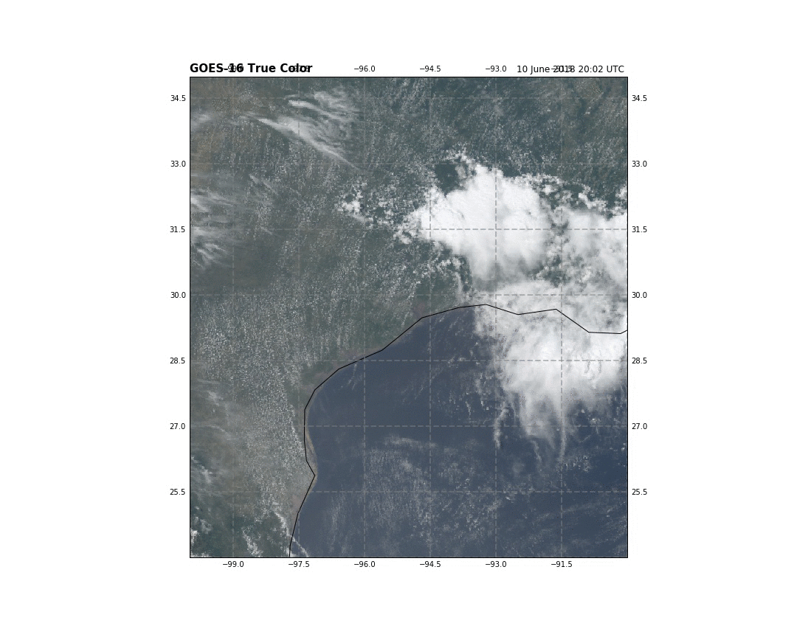
Argonne team plans for TRACER
Focus on public data
ARM’s Radar Engineering team will be building a cell tracking system for C-SAPR 2 and investigating automated sector/RHI scanning.
Our team will extending the work we did for the proposal focusing on KGHX and GOES16 data.
The aim: When conditions are “right” track and tag every ”Cloud” that enters the domain. This open dataset will be the TRACER Cloud Atlas.

Slide 3
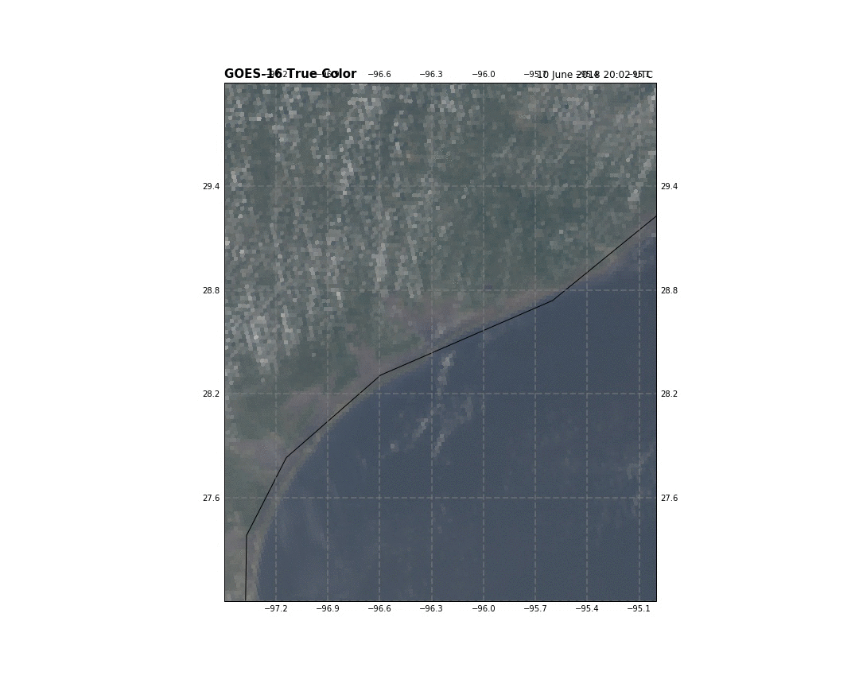
Argonne team plans for TRACER
Focus on public data
ARM’s Radar Engineering team will be building a cell tracking system for C-SAPR 2 and investigating automated sector/RHI scanning.
Our team will extending the work we did for the proposal focusing on KGHX and GOES16 data.
The aim: When conditions are “right” track and tag every ”Cloud” that enters the domain. This open dataset will be the TRACER Cloud Atlas.

Slide 4
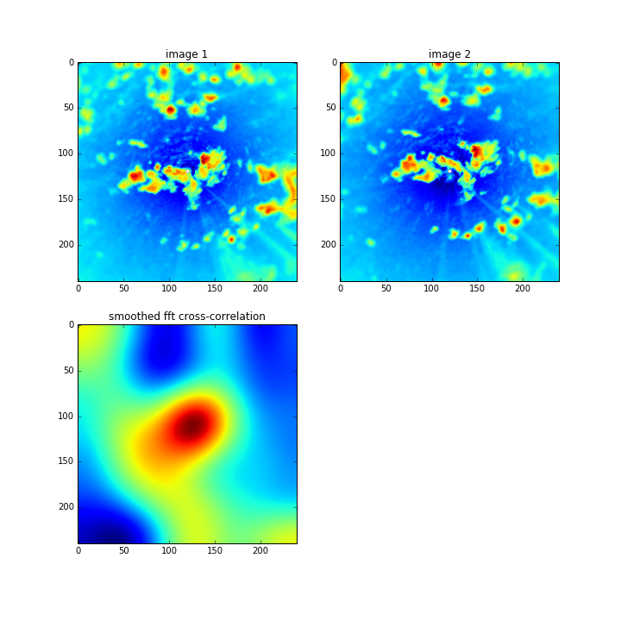
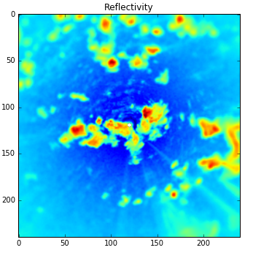
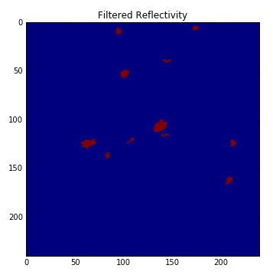
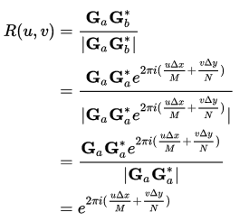
Past work: TINT Tracks from KHGX
TINT: TINT Is Not TITAN
TINT is cell tracking made simpler. Takes a series of Py-ART grids, returns Pandas data frames -> CSV.
Two step: Image cross correlation gives bulk motion. Search picks closest cell to back propagation.
Also detects if cell is isolated.
Described in Fridlind et al 2019

Slide 5
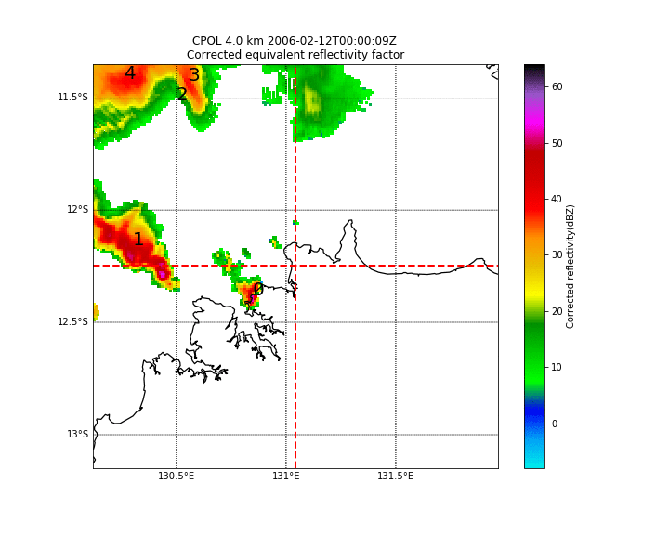

Slide 6
Four year climatology of cells over Houston
Use Dask/IPyParallel to map-reduce. ~512 cores, took O(2days)
7TB NEXRAD data -> 100MB of track data.
Question being addressed: If we sent a radar to Houston how many storms would we see with the full lifecycle in the MUR?
Also: What time of year should we deploy if we have limited resources (which of course we always have). If we were to have an IOP for cell tracking when is best?
411 @ 70 km
2442 @ 150 km
4843 @ 200 km

Slide 7
TINT works on any image data
User Defined Classification
TINT has a highly configurable detection step. Basically users define how a binary mask is created.
It sits on top of Numpy Array objects in Python (soon to be X-Array) so a detection array can be created of any “Image like” data (model data, LIDAR and Satellite).
NEXRAD tells us about precipitating cells, GOES 16 data is open (AWS S3) and very amenable to tracking.

Slide 8
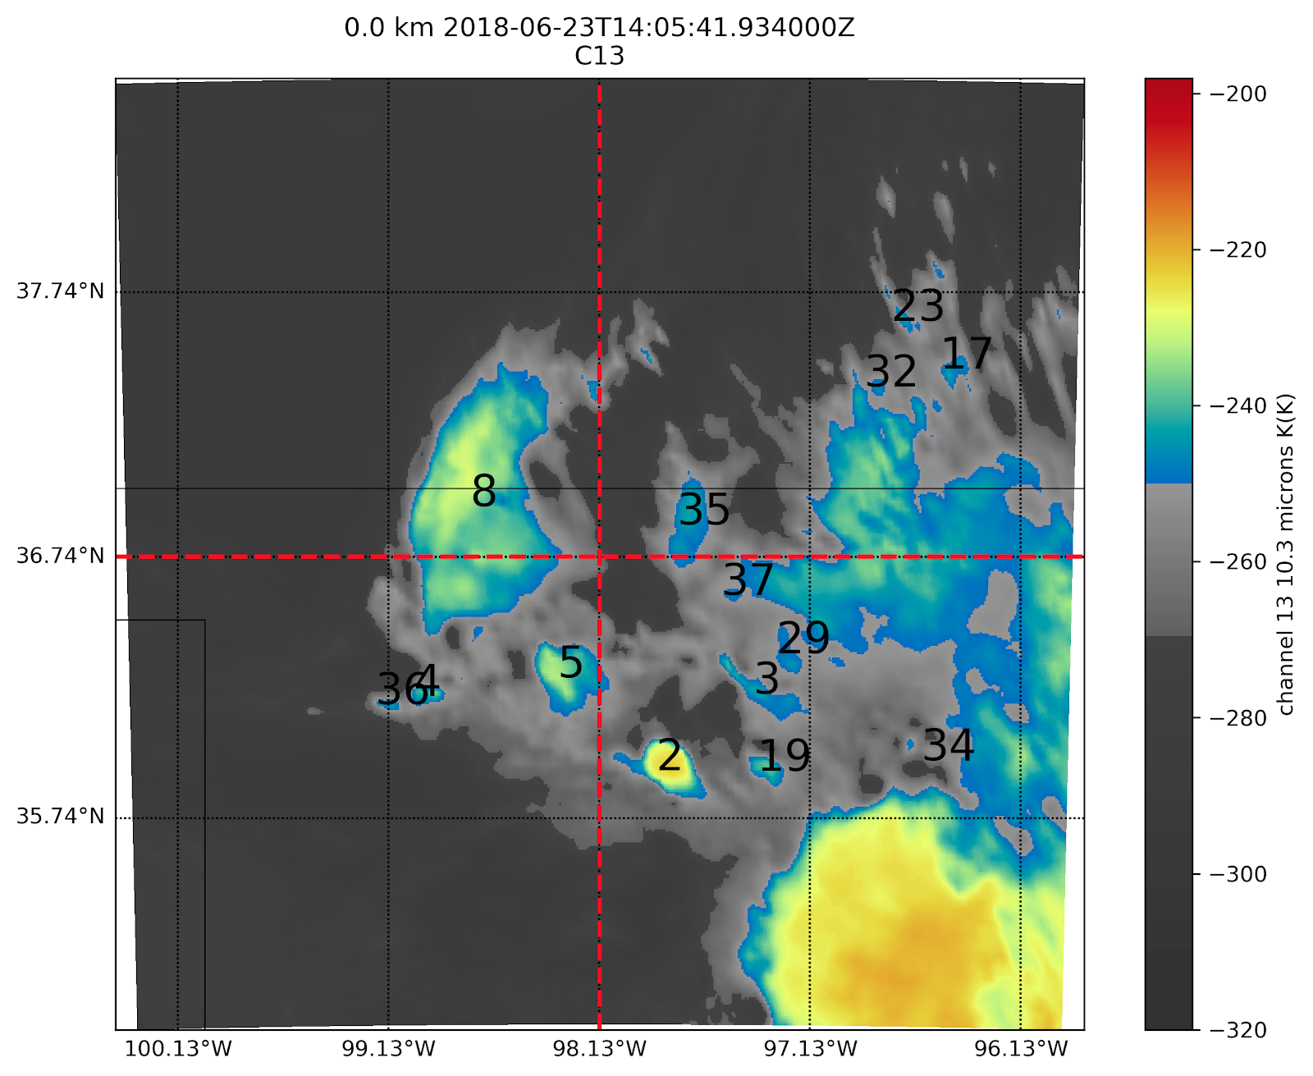
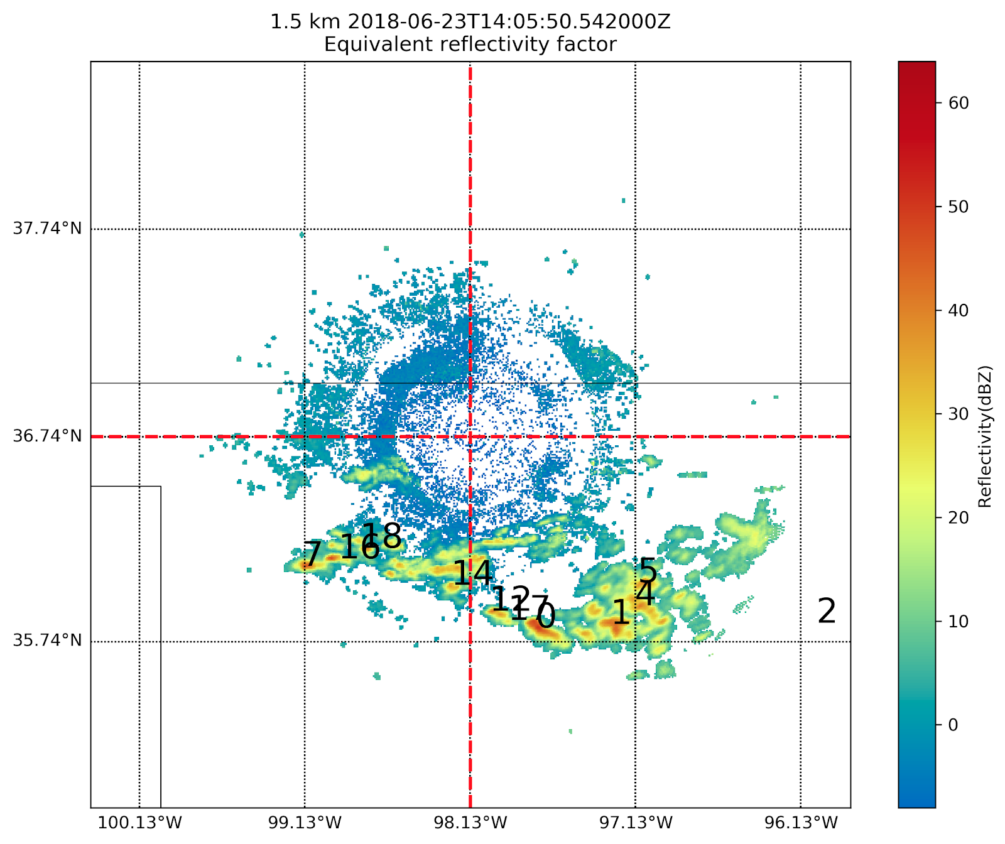
Very initial work
Tracking in both GOES and NEXRAD

Slide 9
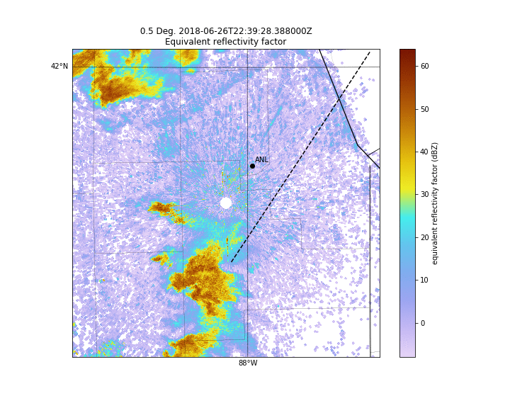
The Cloud Atlas
Plans and caveats
Of course there will be complexities in building the Atlas.. Eg when we have overspreading thick cirrus which will shield convective cores. Every case will be characterized but not every case will be tracked the same.
First plan is to look at some recent cases and identify nice isolated days (in GOES16 era). Summer students May-August.
We also plan to do some track forecasting and build code to suggest scanning patterns via a webservice.
This work is and will be wrapped into several proposals, no solid support for this work with DOE CMDV activity ending.

Slide 10
Thinking big
Labeled data sets for machine
learning
Each object in the Atlas can be labeled with forcing conditions.
All high res (raw data) can also be archived.
DOE’s Exascale vision includes machine learning. TRACER will produce great data.
Partnering with data scientists in DL-Hub https://www.dlhub.org/

Slide 11
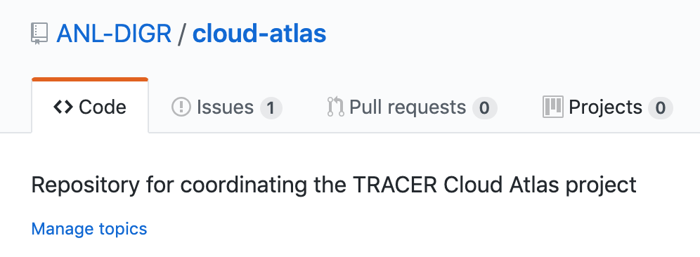
Join us
https://github.com/ANL-DIGR/cloud-atlas
http://bit.ly/traceratlas

Slide 12
Thank you
scollis@anl.gov
@cyclogenesis_au on Twitter
Openradar and evs_atmos on GItHUB for code
This presentation has been created by UChicago Argonne, LLC, Operator of Argonne National Laboratory (“Argonne”). Argonne, a U.S. Department of Energy Office of Science laboratory, is operated under Contract No. DE-AC02-06CH11357. This research was supported by the Climate Model Development and Validation activity funded by the Office of Biological and Environmental Research in the US Department of Energy Office of Science. Computing resources were provided by the Laboratory Computing Resource Center of Argonne National Laboratory.

